Slide 1

International Fact Checking Network (IFCN)
Global Fact Check Fund (GFCF)
2023 Feedback and Q&A
May 8, 2024
Notes:
With over 325 applications created in 2023, this feedback session will focus on the most common issues and trends identified by reviewers. We will be providing information and findings from the 2023 Global Fact Check Fund (GFCF) Applications of BUILD, GROW & ENGAGE.

Slide 2
Agenda
Fund overview
Common errors
Application sections
Grant award cycle
Resources
Q&A
Notes:
Provide a short overview of the Fund and the 3 tiers;
Share summaries of common challenges among the 2023 applications;
Dive into the application sections, their purpose and helpful hints for a strong proposal;
Review a typical grant Award Cycle
Direct you to resources that can assist with applications in 2024;
And jump into any questions you may have.
Please drop your questions into the chat or you may ask them at the end.

Slide 3
Overview of IFCN Global Fact Check Fund (GFCF)
The $12 million fund awards grants in an open competition to help fact-checking organizations around the world strengthening their capabilities
The fund’s mission is to develop the operational, production and engagement capacity of fact-checking organizations in order to increase the quality, volume, frequency, scale and impact of fact checking.
The GFCF is funded by YouTube/Google and is administered by the IFCN with the guidance of the fund’s Steering Committee.
Notes:
The IFCN is continuing a partnership with Google and YouTube to support fact-checking initiatives worldwide and reduce the harm of misinformation by strengthening organization capabilities. This $12 million Global Fact Check Fund supports verified signatories to the IFCN Code of Principles, as well as endorsed, non-signatory, fact-checking organizations.
The International Fact-Checking Network (IFCN) at the nonprofit Poynter Institute, a global leader in journalistic excellence, announced a partnership with Google and YouTube on November 29, 2022 to support fact-checking initiatives worldwide and reduce the harm of misinformation. The $12 million Global Fact Check Fund supports verified signatories to the IFCN Code of Principles, as well as endorsed non-signatory, fact-checking organizations.

Slide 4
2023-2025 Tiers: BUILD, GROW and ENGAGE
BUILD is not project-based. Supports the operations of fact-checking organizations by addressing their material, technical, and/or operational needs
GROW supports the increased development of fact-checking operations through the diversification of revenue streams; growth of organizational technical, human, and operational capacities; and/or enhancing content quality
ENGAGE aims to scale up the reach of content; strengthen and expand audience engagement and innovation; and experiment to develop new tools for fact-checking to support engagement
Notes:
For 2024, the focus of each tier has been refined as a result of direct feedback from the community. This updated information can be found on the grants website.
Please know that applying to a particular grant tier is a decision for each applicant to make.
Unlike most grant opportunities, we have attempted to create non-prescriptive guidance on what you decide to apply for, as you are the best determinate for your capacity building needs.
We do encourage applicants to consider what their needs are in relation to the focus of the grant tier they are interested in. For example, GROW is to support the increased development of operations through perhaps the diversification of revenue streams, growth of organizational technical, human, and operational capacities, and/or enhancing content quality. This focus is to help support an established enterprise to achieve the next level of functioning across the organization.

Slide 5
General Examples of Grant Tier Activities
*-depends on the purpose
 | Purchase equipment | Hire Staff | Purchase software | Activities to reach new or broader audiences | Activities to improve staff capacity | Activities to support continuity of operations
BUILD | X* | X* | X* |  |  | X
GROW | X* | X* | X* |  | X
ENGAGE | X* | X* | X* | X
Notes:
When looking at the differences between BUILD, GROW & ENGAGE, again we encourage each applicant to match their needs to the focus of each grant tier.:
BUILD = Please note that, unlike last year, BUILD is no longer a project-based opportunity. It has been changed to be a resource to support general operations of an organization by addressing their material, technical, and/or personnel needs. For example, applicants for BUILD 2024 could use the funds to pay staff or purchase tools or services that contribute to the continuity of operations, resilience, security, or immediate sustainability of the organization.
GROW = will help established organizations to create new projects or develop project that are ready to be enhanced. This may include efforts to shore up the institutional capacity of the organization.
ENGAGE = supports scaling up the reach of content, or the strengthening & expanding audience or stakeholder engagement and innovation, or experimenting to develop tools for expanding fact-checking.
The Fund exists to support fact checking and cannot be awarded to support:
Organizations with affiliations to elected officials, political parties or religious groups
Humanitarian or charitable activities, including direct social services to populations
Political or partisan activities
Individual trips abroad
Health services or materials
Construction costs
Pre-award costs

Slide 6
Common errors across 2023 applications-info
Missing information (missing uploads, not in English, incomplete answers)
Statement of need was not clear or compelling
Too many objectives, or objectives were not measurable or achievable
Proposed activities were not described in a way that make them realistic and relevant
Indicators were not relevant, or indicators were not measurable with time and resources allotted
Application was not appropriate to the specific tier (BUILD, GROW or ENGAGE)
Notes:
Incomplete answers. Most questions in the application have supporting or help text which rephrase the question or help the applicant understand the components of the question. For instance, a question about “Organizational Background” the help text breaks down what type of information must be included “Briefly describe your organization (How did you begin, how long have you been operating?)”. If the applicant does not provide all of the requested information, the answer may be incomplete. This is the same with required attachments.
In some instances applications were well-written, but the proposal is not well-matched to the purpose of the tier to which the organization is applying. For example, ENGAGE is not well suited for intensive staff capacity building without a connection to increasing audience engagement or innovation. Capacity building for staff may be better suited for GROW or BUILD tiers.

Slide 7
Common errors across 2023 applications-linkages
Activities were not aligned with stated need
Capacities were not matched with activities
Activities and objectives were misaligned
Indicators, objectives and activities were also often not well connected
Budgets or timelines were not clearly connected with activities
Statement of Need / Problem
Organizational Capacities
Objectives / indicators
Timeline & Budget
Action Plan / Activities
Notes:
An important elements of a quality proposal is ensuring that there is agreement between different sections of the application. For example, the Statement of need, a section which helps the reviewers understand the issue your project aims to address and the context in which the project will be executed, should be in agreement with the activities you propose. The activities should be in agreement with the proposed objectives, timelines and budget.
For example, activities showed up in the budget that were not mentioned anywhere else in the proposal. Or a very small staff proposed to implement a significantly large proposal with no additional plan or budget for support.
Alignment between what the problem or the challenge is that exists. Your objective (or the desired change to the existing problem or challenge) and the steps of how toy will make that change happen (or the activities you will undertake)

Slide 8
What issues do NOT get a markdown during review
Incorrect spelling or grammar is not marked down, as long as the ideas are clear. Lack of English language proficiency is not marked down as long as the ideas are clear.
It’s okay to not answer questions marked “optional” in the application
NOTE: While the sections of the applications are the same for BUILD, GROW and ENGAGE, the specific questions within them will vary. Also, how many points each question is worth will vary
Notes:
The fact-checking community is diverse and representative of many geographic locations. We appreciate that for a lot of our fact-checkers English is often not the second, third or even fourth language. So please know, as long as your point is clear, no points are deducted for spelling, grammar or vocabulary issues.

Slide 9
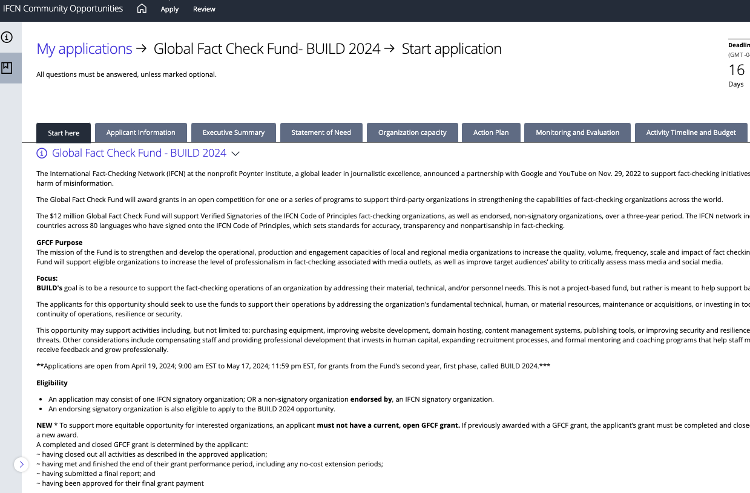



IFCN Community Opportunities Grant Portal
Notes:
Well, to begin, interested applicants will visit the grants website and click on the grants portal registration link.
Once there, upon registration, you will see available opportunities on your dashboard.
For example, selecting the current opportunity (BUILD 2024) will bring you to the application, where you will be guided by a series of tabs.
The “Start here” tab provides specific information on eligibility, expectations and a link to the grant terms and conditions.
The next tab, “Applicant Information” is not scored and helps IFCN to determine if the applicant is eligible to apply for a specific round of funding, as well as help reviewers understand your organization a bit more.

Slide 10
Section: Executive Summary
Purpose: To get a solid overview of your organizational background. To understand why you are requesting funding and the strategies you will use in achieving objectives. To show how your request aligns with the purpose of BUILD or GROW or ENGAGE.
TIP: To receive a high score, the answers must be complete, meaning that there are no big gaps or additional information that the reviewers would need to understand: (1) who you are as an organization, (2) what you want to do and why and (3) why this specific tier of funding
Notes:
This section is similar to your “pitch”, your “hook” or simply the first step in engaging your audience - the reviewers.
You will be sharing:
(1) who you are as an organization,
(2) what you want to do and why, and
(3) why this specific tier of funding is a match for your application
Answers must be complete, meaning that there are no big gaps or additional information that the reviewers would be lacking in order to understand this section.

Slide 11
Section: Statement of Need
Purpose:To understand what operational or technical problem is faced by your organization or the target population you serve.
TIP: Good answers include: (1) Statements backed up by evidence. (2) Clear description of barriers your organization faces in addressing the problem and the impact of not receiving funding to support your activities. (3) Statement of need clearly linked to the proposed activities and objectives
Notes:
This section is an opportunity for the reader (reviewer) to learn about the more significant challenge that you have identified, something that really needs to be addressed.
If you are vague about the problem OR if your issues is a “nice to have it fixed” challenge, then it may not be understood as a compelling or strong need to your reader. What else could make it stronger? Evidence, data, numbers or reference to documented impacts of not having the need addressed will give a more in-depth picture for the reviewer.
If you have a lot of needs, make sure to identify the most achievable need that can be addressed with the resources that you will have, within the award budget and in the timeline available for the grant period.
This provides reviewers with a strong and compelling “why” for your application

Slide 12
Section: Organizational Capacity
Purpose: To better understand your organization’s experience in dealing with the issue and your capacity to address it and/or implement proposed activities.
TIP: Strong answers include specifics on past experience in addressing the problem, human resources to implement the proposed activities, and information about the partner organization (if any) and their role and value-add to the proposed activities.
The statement of need, the organizational capacity and the action plan sections must be clearly linked together to provide a reviewer with a clear picture of the (1) issue to be addressed, (2) your ability to address it and (3) the appropriateness and ambition of the activities to address it.

Slide 13
Section: Action Plan
Purpose: To help reviewers understand the strategies and activities that you will undertake.
Please share the objective (or the change to which a project, programme or organisation wants to achieve or contribute) and share what activities will be conducted to achieve the objective and resources form implementation.
TIP: A good response includes an objective or objectives which are achievable and address the problem stated. The activities must be clearly linked to the objective. Barriers to implementing them should be well described, and the proposed activities must address the need in the Statement of Need section. Reasonable staffing allocated.

Slide 14
Section: Monitoring and Evaluation (M&E)
Purpose: To share your proposed measurements for the activities and objectives, so that reviewers and IFCN staff will know how your project is progressing.
Without realistic and sensible measures, it is not possible to know what was accomplished with the funds.
TIP: It is important to link the measures/ indicators to the activities and the objectives in your proposal. Without a clear connection between the objectives, proposed activities and the indicators, the M&E section cannot be rated highly.
Notes:
We do not have a specific set of objectives or indicators that you must tell us. We want YOU to tell us what is important to you-based on the need you are trying to address. Often funders will tell you the objectives or the indicators.

Slide 15
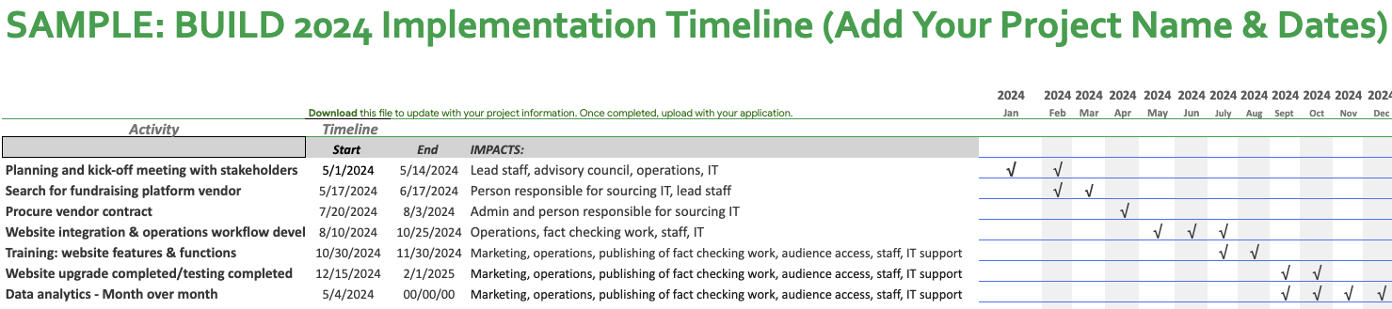
Section: Activity Timeline
Notes:
Activity timeline-where all activities and their tentative timelines are listed. Thoughtful timelines are consider all activities and M&E proposed in the action plan and M&E sections respectively, are realistic given the proposed scope of work and resources.-Please edit the form as needed!

Slide 16
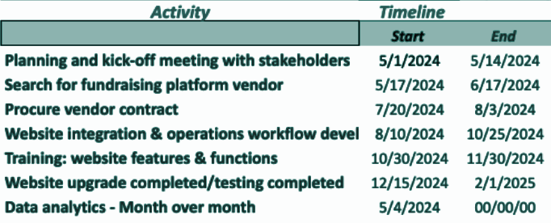
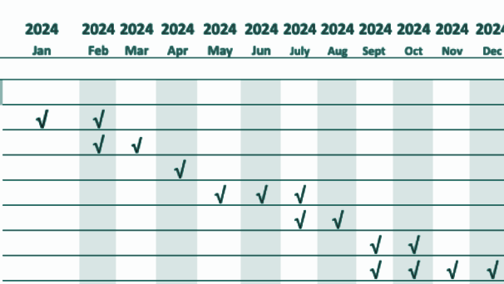
Section: Activity Timeline
Notes:
Tip: because of the timeline (to review applications, announce awards and finalize contracts) we suggest designing your project, or in the case of BUILD your activities, to begin sometime between 8-10 weeks after the close of applications. While we understand that timelines may need to be shifted, this time frame will allow for a more realistic timeline.
Please also don’t forget to consider predictable events, such as staff time off, and if you know that a lot of your staff may not be available during a certain time (winter or summer holidays), you may consider avoiding having those time periods be deadlines for any proposed activities or reporting.

Slide 17
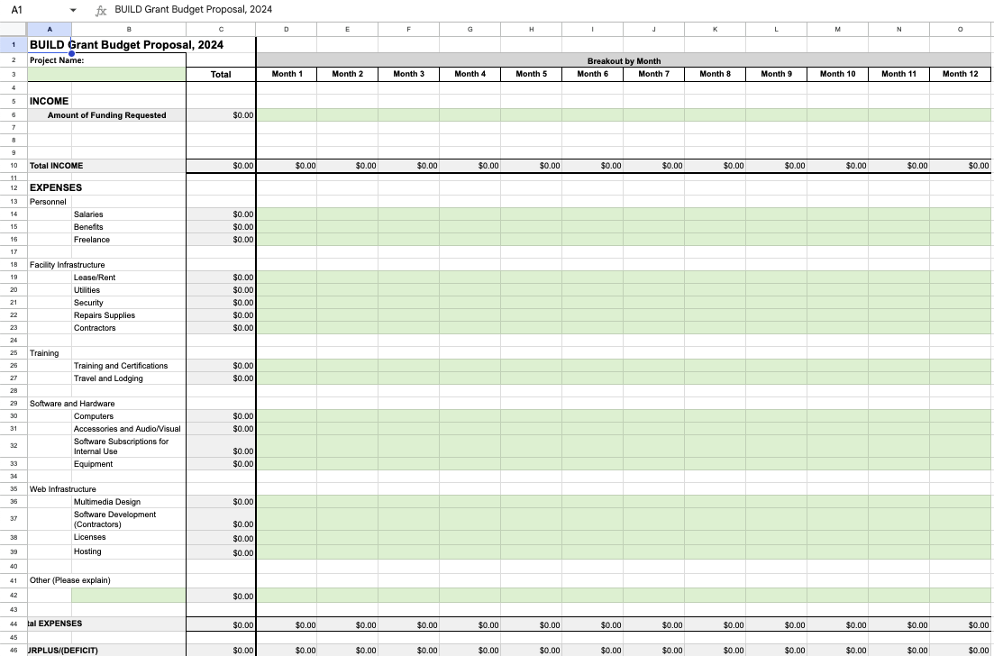
Section: Proposal Budget
Notes:
The budget template requests that you put together a detailed budget for your proposed initiative, taking into consideration staff time, monitoring & evaluation activities, etc.
Go back to your Action Plan and Activity Timeline.
Ask some questions - For example, Will the budget support the people needed to implement the activities for the entire grant period? Will there need to be equipment purchases, training on the equipment and maintenance costs?
Will your staff need certifications to improve specific skills that will be tied to an activity?
Please do not include line items that are not clearly linked to the proposed activities. Reviewers will stop to look for this information elsewhere in your application and will most likely consider this a weaker budget if it exists as a stand-alone, mysterious item.
-Please edit the form as needed!

Slide 18
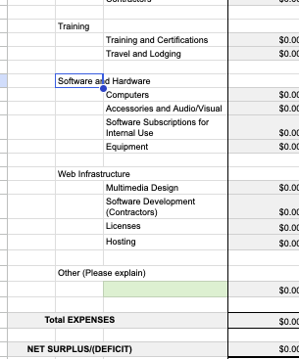
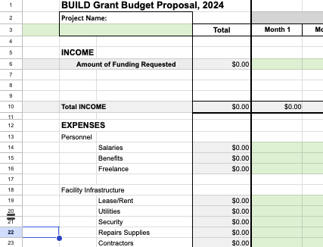
Section: Proposal Budget
Notes:
Please note that we cannot reimburse any costs related to the proposal done before the official award date.
Also please be sure to use a reasonable currency converter to the USD.
Reviewers will be looking for reasonable costs for things such as contractor, freelancers, salaries and other line items.
For BUILD 2024, if your proposal is top-heavy with salaries, please be clear on how this is the best use of funds for your operations.
and consider implications when deciding on budget allocation. Personnel; Facility Infrastructure; Training; Subscriptions; Software and Hardware; Web Infrastructure; Other - this category is to make sure that you can describe line items which require a budget, but may not fit into the categories above.

Slide 19
Grant Application to Award Timeline
Reviewer comments and scores are compiled
Final award determinations are made
Awardees are notified via email/ contracts sent out
Those who did not win are also notified via email
IFCN holds a Q&A for applicants 1 week after announcement
IFCN answers questions via info@ifcn.org
APPLICATION CLOSES (4-5 weeks)
ANNOUNCEMENTS
OPEN APPLICATION (4-5 weeks)
REVIEW COMPLETE
IFCN reviews applications for eligibility
IFCN holds orientation session for application reviewers
IFCN assigns applications for review
Announcement made on the website
Contracts, timelines and budgets finalized as needed
Orientation for new grantees
Projects launch

Slide 20
Resources
How to Apply for GFCF Grant Guide (BUILD 2024) - IFCN-GFCF website, under “Resources”
GFCF BUILD/GROW/ENGAGE Q&A webinar-usually within 1-2 weeks of application launch (recording to the BUILD 2024 Q&A on the IFCN website)
info@ifcn.org email address for all questions during the application process
Grants Course via Poynter-FREE! Search “Grant Writing for Journalists” - May 2024
GlobalFact 11 Conference: Training Workshop - Grant Application Skills

Slide 21
Q&A
Notes:
We will be happy to answer your general questions at this time. Please remember this is not an individual feedback session. So please ask your questions in a way that will be helpful and inform others. If you have questions specific to your application, please reach out to us at info@ifcn.org with the subject line “Name of grant (BUILD 2023, GROW 2023 or ENGAGE 2023) Application Question”

